Slide 1
DarkSoCV on Sky130 – Hierarchical Implementation
With the darkram (bram0) block pre-implemented
Innovus · Tempus · Pegasus

Slide 2
Why hierarchical
Motivation for splitting the design
Flat implementation
Hierarchical implementation
Whole design, including the RAM, implemented in one pass
Long run times at every stage
Each iteration repeats work on the RAM
RAM (darkram) implemented separately first
Result used as a pre-implemented block, bram0
Top-level runs handle only the glue logic around it
The flat implementation took too long, so the design was re-done hierarchically to shorten the implementation effort.
DarkSoCV (hier) · sky130 · PnR → Signoff
2

Slide 3
Implementation flow
Hierarchical: pre-implemented bram0 block plus top-level glue logic
1
Floorplan & power plan
2
Placement
3
Pre-CTS opt
Macro + std-cell region
Glue logic around bram0
timeDesign -preCTS
4
Clock tree
5
Route
6
Signoff
CTS + CTD debug
NanoRoute + ECO
Tempus · Pegasus
Signoff coverage: STA at the typical corner (Tempus 23.14) and DRC (Pegasus 22.13).
DarkSoCV (hier) · sky130 · PnR → Signoff
3

Slide 4
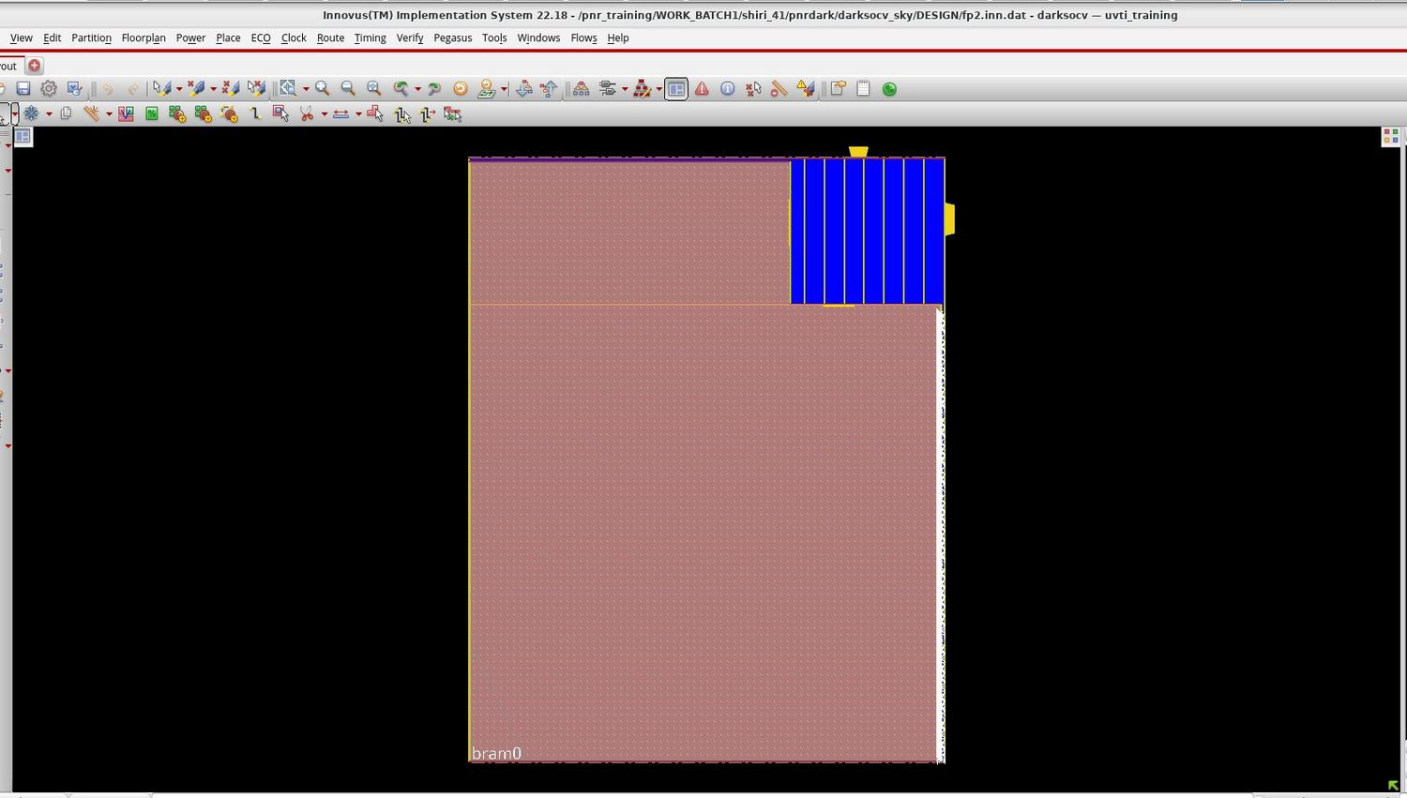
Floorplan & power plan
fp2.inn.dat · darkram (bram0) placed as a pre-implemented block
bram0 (darkram) was implemented separately and is used here as a block; it occupies most of the core
Standard-cell glue logic sits in the top-right region
Vertical power stripes serve the logic region
IO pins on the top and right edges
Saved as the fp2 checkpoint before placement
DarkSoCV (hier) · sky130 · PnR → Signoff
4

Slide 5
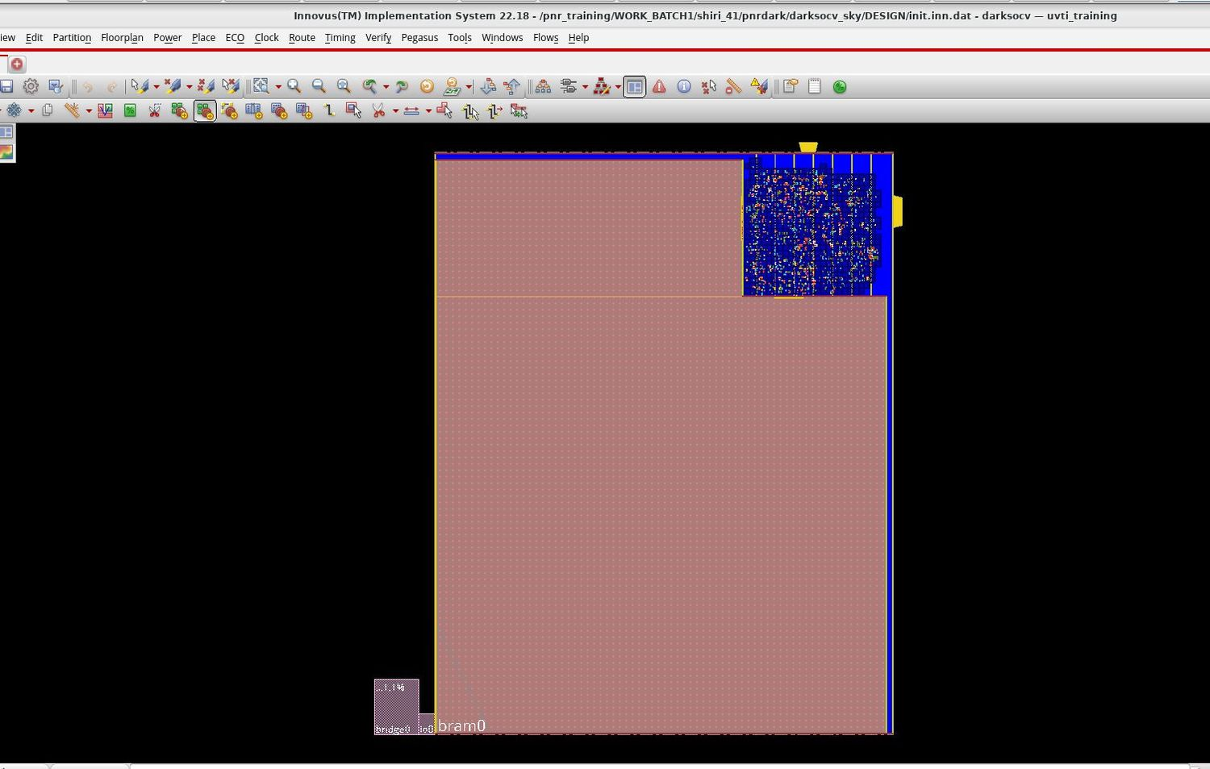
Placement view
init.inn.dat · glue logic placed around the fixed bram0 block
Logic cells are confined to the top-right region
bram0 stays fixed as a hard block
Cell density is concentrated, so routing resources in that region matter
Congestion is checked from this view
DarkSoCV (hier) · sky130 · PnR → Signoff
5

Slide 6
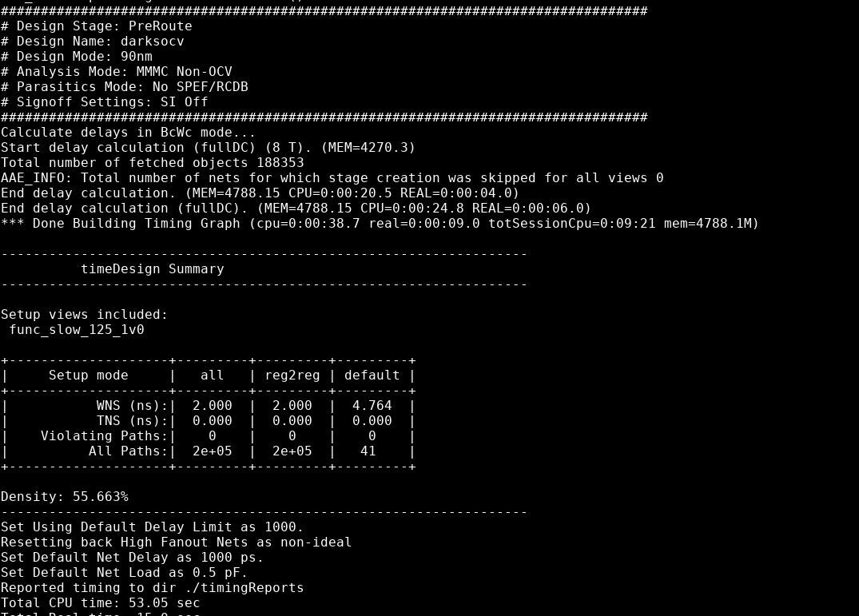
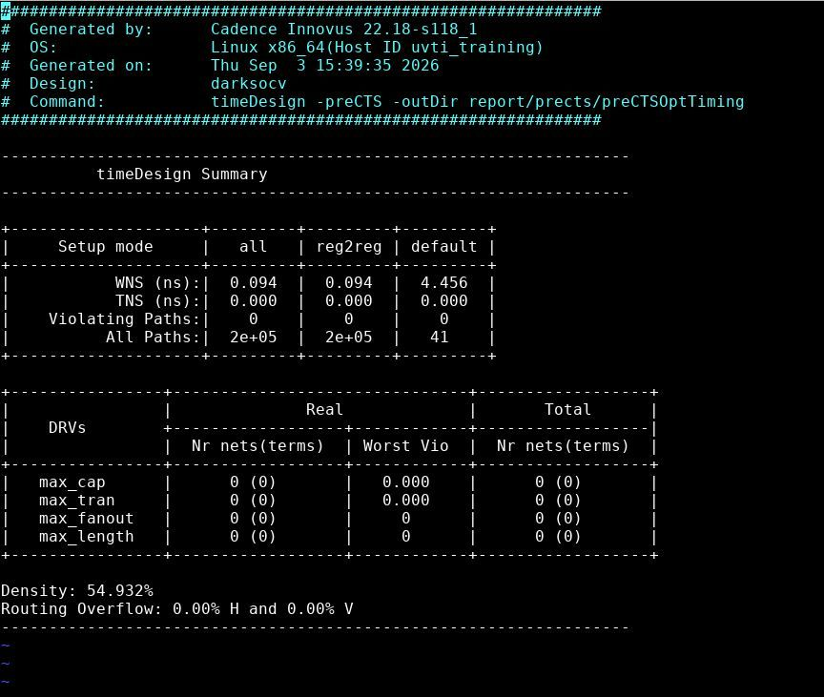
Placement & pre-CTS timing
Innovus timeDesign summaries
Post-placement timeDesign (view func_slow_125_1v0)
timeDesign -preCTS
+2.000 ns
0
+0.094 ns
0 DRVs
WNS · density 55.7%
violating paths
WNS · density 54.9%
overflow 0.00% H / V
DarkSoCV (hier) · sky130 · PnR → Signoff
6

Slide 7
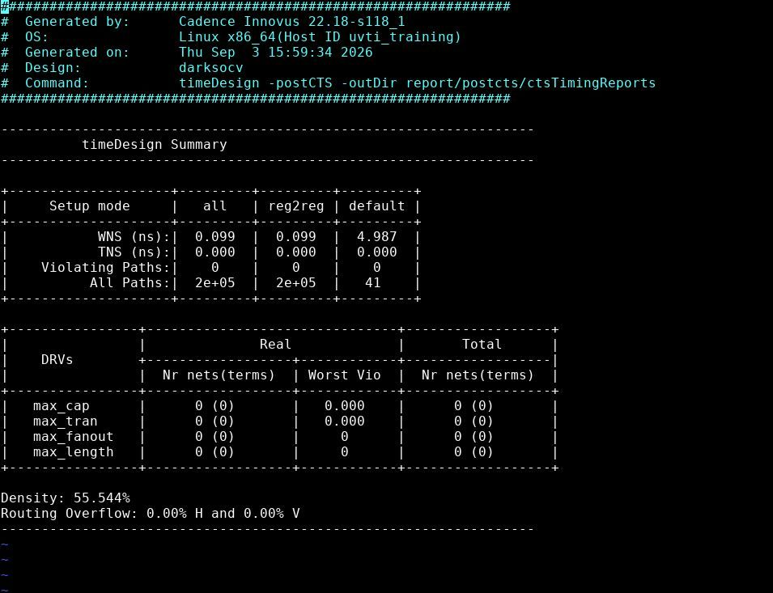
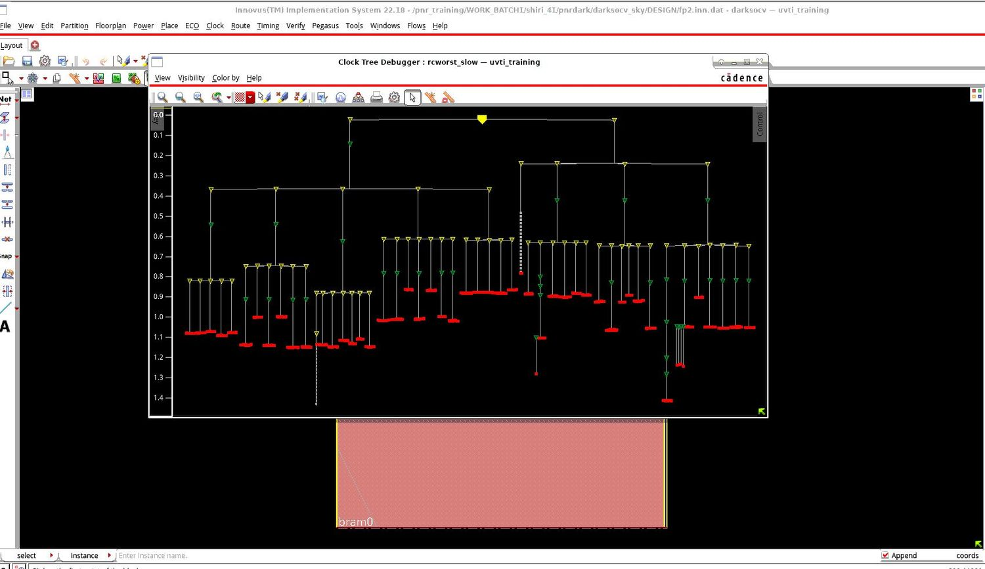
Clock tree & post-CTS timing
Clock Tree Debugger, rcworst_slow corner
timeDesign -postCTS
Post-CTS WNS +0.099 ns, 0 violating paths, 0 DRVs
Density 55.5%, routing overflow 0.00%
Most sink insertion delays about 0.8–1.2 ns; a few deeper branches near 1.4 ns (read from plot)
DarkSoCV (hier) · sky130 · PnR → Signoff
7

Slide 8
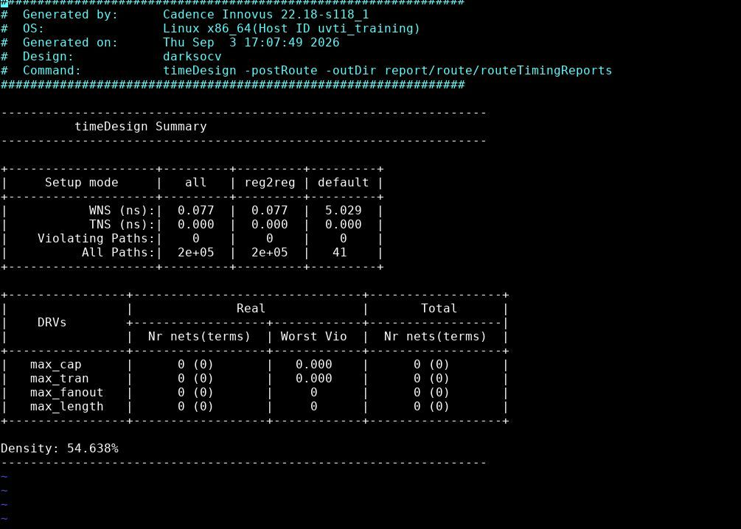
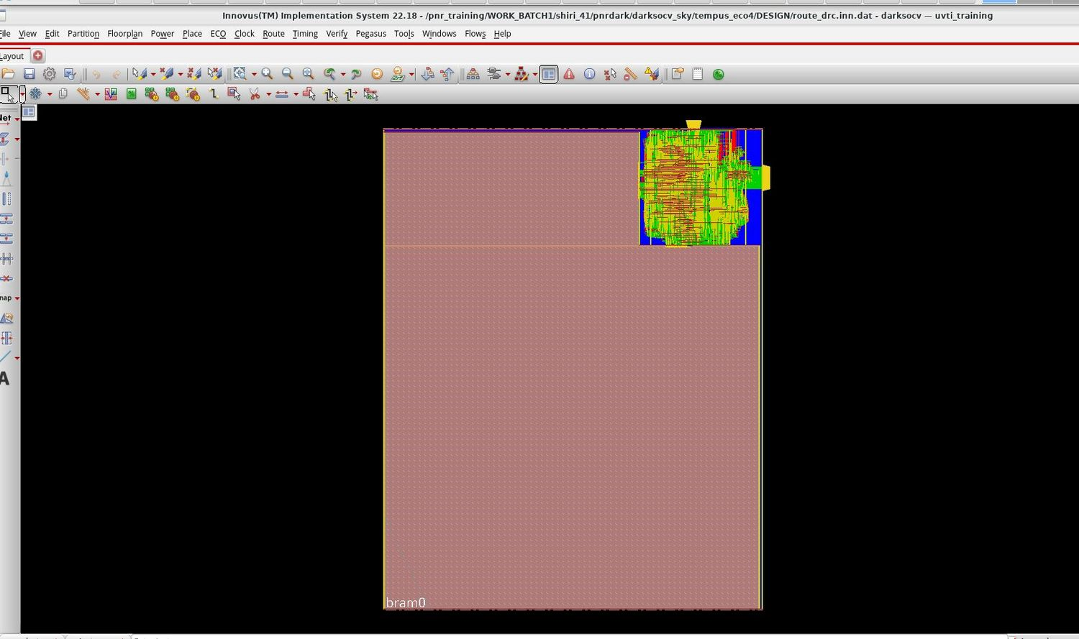
Routing & post-route timing
Routed database (tempus_eco4) · timeDesign -postRoute
Routed design
Post-route timing summary
+0.077 ns
0
0
54.6%
WNS · TNS 0.000
violating paths
max cap / tran / fanout / length
final density
DarkSoCV (hier) · sky130 · PnR → Signoff
8

Slide 9
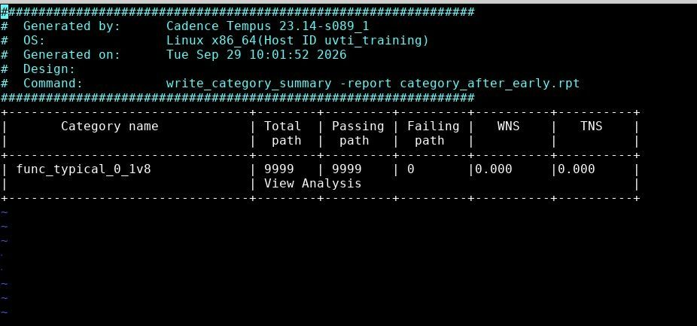
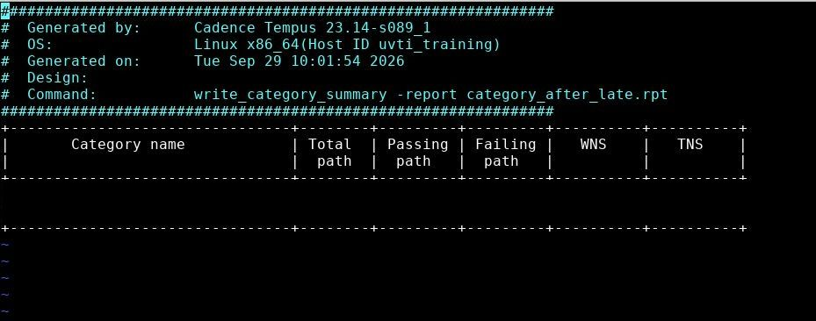
Tempus signoff
Typical corner (func_typical_0_1v8), early and late
category_after_early.rpt
category_after_late.rpt
0 failing
0.000
0 failing
0.000
early / hold
WNS & TNS
late / setup
WNS & TNS
DarkSoCV (hier) · sky130 · PnR → Signoff
9

Slide 10
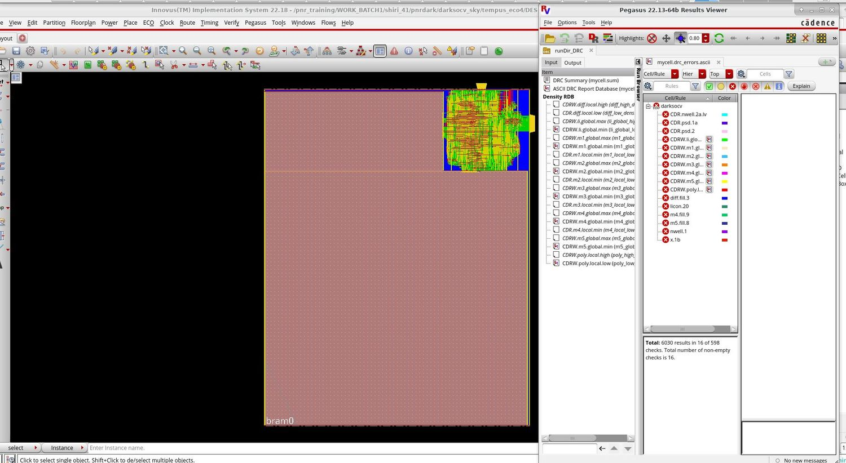
Physical verification – DRC
Pegasus 22.13 · runDir_DRC · mycell.drc_errors.ascii
6,030
results in 16 of 598 checks · PDK-related
Well and implant rules: CDR.nwell.2a.lv, CDR.psd.1a, CDR.psd.2, nwell.1, x.1b
Density-window rules: CDRW.li, m1–m5, poly
Fill rules: diff.fill.3, m4.fill.9, m5.fill.8; also licon
Root cause: sky130 PDK rule set, left as a known PDK issue
DarkSoCV (hier) · sky130 · PnR → Signoff
10

Slide 11
Signoff scorecard
Check | Status | Key result
Post-route timing (Innovus) | PASS | WNS +0.077 ns, 0 violating paths, 0 DRVs
STA signoff (Tempus) | PASS | Typical corner: 0 failing paths, WNS and TNS 0.000, early and late
DRC (Pegasus) | PDK ISSUE | 6,030 results in 16 of 598 rules, from the sky130 rule set
DarkSoCV (hier) · sky130 · PnR → Signoff
11

